Slide 1

AI and Knowledge Representation for Healthcare
Dan McCreary
April 23, 2024

Slide 2
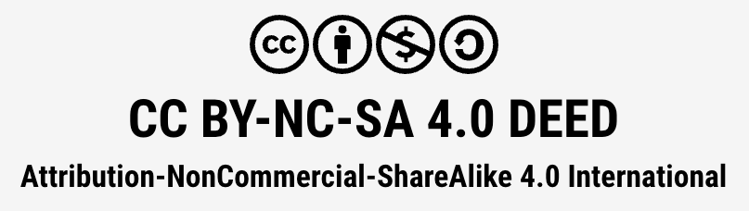
Content License
You are free to:
Share — copy and redistribute the material in any medium or format
Adapt — remix, transform, and build upon the material
The licensor cannot revoke these freedoms as long as you follow the license terms.

Slide 3
License Restrictions
Attribution — You must give appropriate credit, provide a link to the license, and indicate if changes were made. You may do so in any reasonable manner, but not in any way that suggests the licensor endorses you or your use.
NonCommercial — You may not use the material for commercial purposes.
ShareAlike — If you remix, transform, or build upon the material, you must distribute your contributions under the same license as the original.
No additional restrictions — You may not apply legal terms or technological measures that legally restrict others from doing anything the license permits.

Slide 4

About Dan McCreary
Solution architect
Author of "Making Sense of NoSQL"
Former Distinguish Engineer at UHG/Optum
Led the creation of the world's largest know knowledge graph for healthcare (25B vertices and 130B edges)
Former Head of Optum Generative AI Center of Excellence
Teaching courses in Systems Thinking for over ten years
Standards advocate (ISO, W3C)
Big fan of AI, Knowledge Representation, Gen AI and Education
My gift: I can see data movement

Slide 5

Talk Title: AI and Knowledge Representation for Healthcare
This talk will discuss the leading candidates for knowledge representation to power intelligent agents in healthcare. We will cover the pros and cons of using flat files, knowledge graphs, neural networks, and reference frames. We will then look at real-world use cases that have used various architectures and finally see the future of AI in healthcare.
Throughout this presentation, we will take a holistic systems-thinking approach to understand the legacy forces that are preventing innovation.

Slide 6
Key Questions
What is AI?
What is Knowledge Representation?
Review of Systems Engineering concepts in healthcare
AI in medical devices
Review two Systems: FFS and VBC systems
What are intelligent agents?

Slide 7
What is INCOSE?
The International Council on Systems Engineering (INCOSE) is a not-for-profit membership organization founded in 1990. Our mission is to advance the state of the art and practice of systems engineering in industry, academia, and government by promoting transdisciplinary, scaleable approaches to produce technologically appropriate solutions that meet societal needs.

Slide 8
The INCOSE Healthcare Working Group
The Healthcare Working Group seeks to improve healthcare delivery in the world by bringing together systems engineers and systems thinkers in healthcare system to identify, develop, and tailor best practices for the improvement of healthcare delivery. We will achieve that by:
Articulating the value and application of systems engineering to healthcare through simple examples and easily deployable guidelines, and
Providing a forum for developing and sharing best practices, meeting world class experts in Systems Engineering and Healthcare (and across other industries).
Our on-going goal is to aggregate information that articulates the value and application of systems engineering to the biomedical and healthcare industries and to provide an infrastructure for members and interested non-members to share relevant information.

Slide 9
What is AI?
Artificial Intelligence (AI) refers to the development of computer systems and software that can perform tasks typically requiring human intelligence, such as learning, reasoning, problem-solving, perception, and natural language processing.
It encompasses a broad range of technologies, from basic automation and machine learning to advanced neural networks and deep learning algorithms. Question: Are smart speakers (Alexa) AI?

Slide 10

AI is a Wavefront of Evolving Technologies
Artificial intelligence is evolving so rapidly that we can barely keep up with it
AI represents a wavefront of technology that will redefine industries, economies, and human interactions What was AI yesterday is mundane today. What AI is today will be mundane tomorrow.

Slide 11
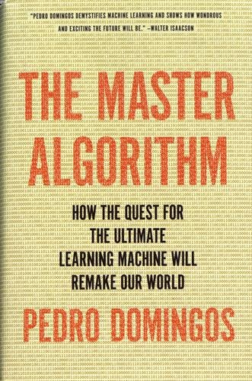
The Master Algorithm's Five Factions
Symbolists: This faction emphasizes logic and human-readable rules. They focus on symbolic reasoning and knowledge-based systems, often relying on expert knowledge and structured logic to create AI systems. Example: Knowledge Graphs
Connectionists: This group is centered around neural networks and deep learning. Connectionists use models that emulate brain-like structures, focusing on pattern recognition and learning from vast amounts of data. Example: Deep Neural Networks
Evolutionaries: The evolutionaries take inspiration from biological evolution, using genetic algorithms and evolutionary strategies. They evolve solutions over generations, applying principles like mutation and selection to optimize AI models. Example: Reinforcement Learning
Bayesians: This faction relies on probability and statistics to build AI systems. They focus on Bayesian networks and probabilistic reasoning, using data to update beliefs and make predictions. Example: Bayesian Deep Learning
Analogizers: This group is based on the concept of analogy and similarity. They use methods like k-nearest neighbors and support vector machines, emphasizing case-based reasoning and finding patterns by comparing data points. Example Vector Stores

Slide 12
Modern Factions of AI
Symbolic AI and Expert Systems: This faction emphasizes rule-based systems, symbolic reasoning, and logic-based AI. It focuses on creating AI through structured, human-readable rules and expert knowledge, leading to applications like expert systems and knowledge graphs. (Good old-fashioned AI)
Machine Learning and Deep Learning: This faction focuses on data-driven approaches, particularly neural networks. It includes sub-factions like:
Deep Learning: Uses multi-layered neural networks to learn complex patterns from data.
Reinforcement Learning: Centers on learning through interactions and feedback, often applied to robotics and gaming.
Transfer Learning: Uses pre-trained models and adapts them for specific tasks, facilitating faster training with fewer resources.
Hybrid AI: This faction combines symbolic AI and machine learning, aiming to leverage the strengths of both approaches. It advocates for integrating rule-based reasoning with neural networks to create more robust and interpretable AI systems.
Neuro-Symbolic AI: A variant of hybrid AI that emphasizes combining neural networks with symbolic reasoning, promoting explainability and generalization.

Slide 13

The Jellyfish and the Flatworm
https://dmccreary.medium.com/the-jellyfish-and-the-flatworm-bdad78e6f68b

Slide 14

The Elegant Jellyfish
Floats in the open ocean
Central requirements of central nervous system:
Low power
Reacts only when a fish swims into its tentacles

Slide 15

The Flatworm
Moves around its environment
Avoid predators
Seek prey
Must build an accurate model of the world in its brain to survive
Brains are "prediction machines" that constantly seek to understand causality
Image credit: https://vimeo.com/37417377

Slide 16
Practical Definition for Organizational Strategy
AI is about creating ever more precise models of the world within our organizations and using these models to make predictions that benefit your stakeholders.

Slide 17
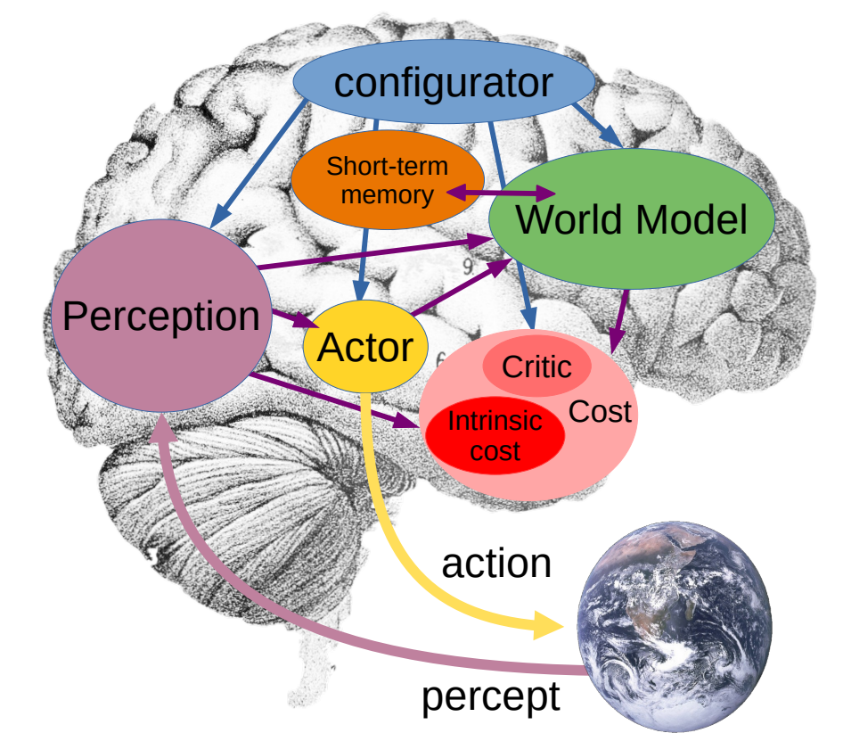
Yann Lecun's Modular Cognitive Architecture
World Models are used to predict the future state based on your actions
Planning is about understanding how actions change world models in the future
Source: https://openreview.net/pdf?id=BZ5a1r-kVsf
YouTube: https://youtu.be/MiqLoAZFRSE?si=KvFwiDTgt0bUMo0H&t=1288

Slide 18

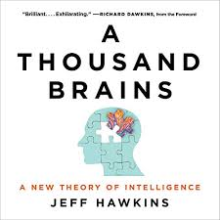

Knowledge Representation
The key to artificial intelligence has always been the representation.
Jeff Hawkins

Slide 19
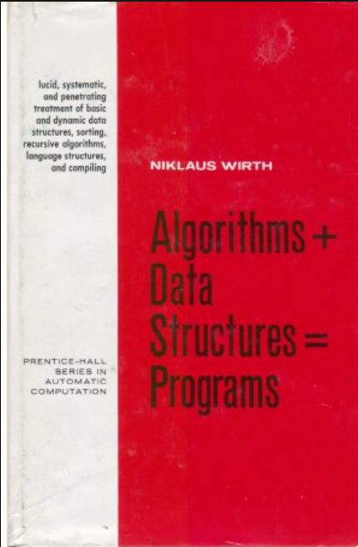
Algorithms + Data Structures = Programs
1976 book written by Niklaus Wirth
Algorithms and data structures are inherently related
Algorithms + Representation = AI

Slide 20
We Need More Systems Thinkers in Healthcare
The creation of our group was driven by the fact that many if not most of the organizations in the biomedical and Healthcare industries do not necessary recognize or understand the value of systems engineering and could thus benefit from the application of INCOSE principles.

Slide 21

Generative AI Architectural Concepts and Patterns
Large-language Models
Generative AI
Chatbots
Agents
Similarity and Embeddings
Knowledge Graphs
Concept Indexes
Vector Databases
https://dmccreary.github.io/genai-arch-patterns/

Slide 22
Summary of Systems Engineering
Holistic Approach: Systems engineering emphasizes a holistic, integrated view of complex systems, ensuring that the system's various components work together to meet the desired objectives. This approach is essential in managing complex projects across different disciplines, such as aerospace, defense, healthcare, and information technology.
Lifecycle Focus: Systems engineers consider every phase of a system's life cycle, from concept development through design, production, operation, maintenance, and disposal. This lifecycle focus helps in optimizing the system not only for initial performance but also for long-term sustainability and adaptability.
Problem Solving: Systems engineering uses structured problem-solving processes that involve requirements definition, system architecture design, implementation, verification, and validation. This structured approach helps in dealing with complex systems and ensures that all stakeholder requirements are met.
Stakeholder Needs: Central to systems engineering is the focus on understanding and balancing the needs of various stakeholders involved in or affected by the system. This often involves trade-offs to reconcile differing objectives and constraints.
Interdisciplinary Teamwork: Systems engineering requires collaboration across various disciplines. Teams often include professionals from diverse fields such as engineering, business, customer service, and project management, working together to ensure that all aspects of the system are considered and integrated.

Slide 23
Ask ChatGPT
GPT-4 Prompt: What are the main topics in the INCOSE Certified Systems Engineering Professional (CSEP) that I can align with when I teach a class on generative AI?

Slide 24
Topics for Systems Thinking and AI (1 of 3)
Systems Thinking: Emphasize the holistic approach to understanding complex systems and their interrelationships. Apply this concept to generative AI by discussing how AI models fit into larger ecosystems, including data, software, and hardware.
Systems Engineering Life Cycle: Discuss the various stages of the systems engineering life cycle, such as requirements analysis, design, implementation, testing, and maintenance. Relate these stages to the development and deployment of generative AI models, including the importance of each phase in ensuring robust and reliable AI systems.
Requirements Engineering:Highlight the importance of defining clear requirements when building systems. In the context of generative AI, this involves determining what the AI system should achieve, the data requirements, and the expected outcomes. Discuss how requirements can evolve and how they impact AI system development.

Slide 25
Systems Thinking and AI (2 of 3)
Verification and Validation: Teach the concepts of verification (ensuring the system meets specifications) and validation (ensuring the system meets user needs). For generative AI, this translates to testing AI outputs against predefined criteria and user expectations, ensuring accuracy, reliability, and ethical compliance. Risk Management: Discuss risk identification, assessment, and mitigation strategies. In generative AI, this involves addressing potential risks such as bias, ethical concerns, security vulnerabilities, and unintended consequences. Teach students how to proactively identify and manage these risks. Configuration Management: Explore the principles of maintaining consistency in system design and operation. Relate this to generative AI by discussing version control, model tracking, and reproducibility in AI development.

Slide 26
Systems Thinking and AI (3 of 3)
Human Factors and Human-Systems Integration: Examine the interaction between humans and systems. Apply this to generative AI by discussing user interfaces, user experience, and ethical considerations in human-AI interaction.
Systems Architecture and Design: Address the design principles and structures that underpin complex systems. Relate this to generative AI by exploring the architecture of AI models, scalability, and modularity in AI system design.

Slide 27
MVB - a simplified framework for AI development
Model
Validate
Benchmark
Model - Create an accurate as possible model of your business entities
Validate - Validate your model with typical questions that stakeholders will ask
Benchmark - Populate your model with real or synthetic data and verify that the queries will execute at scale and under a simulated load within the service levels that your users desire

Slide 28
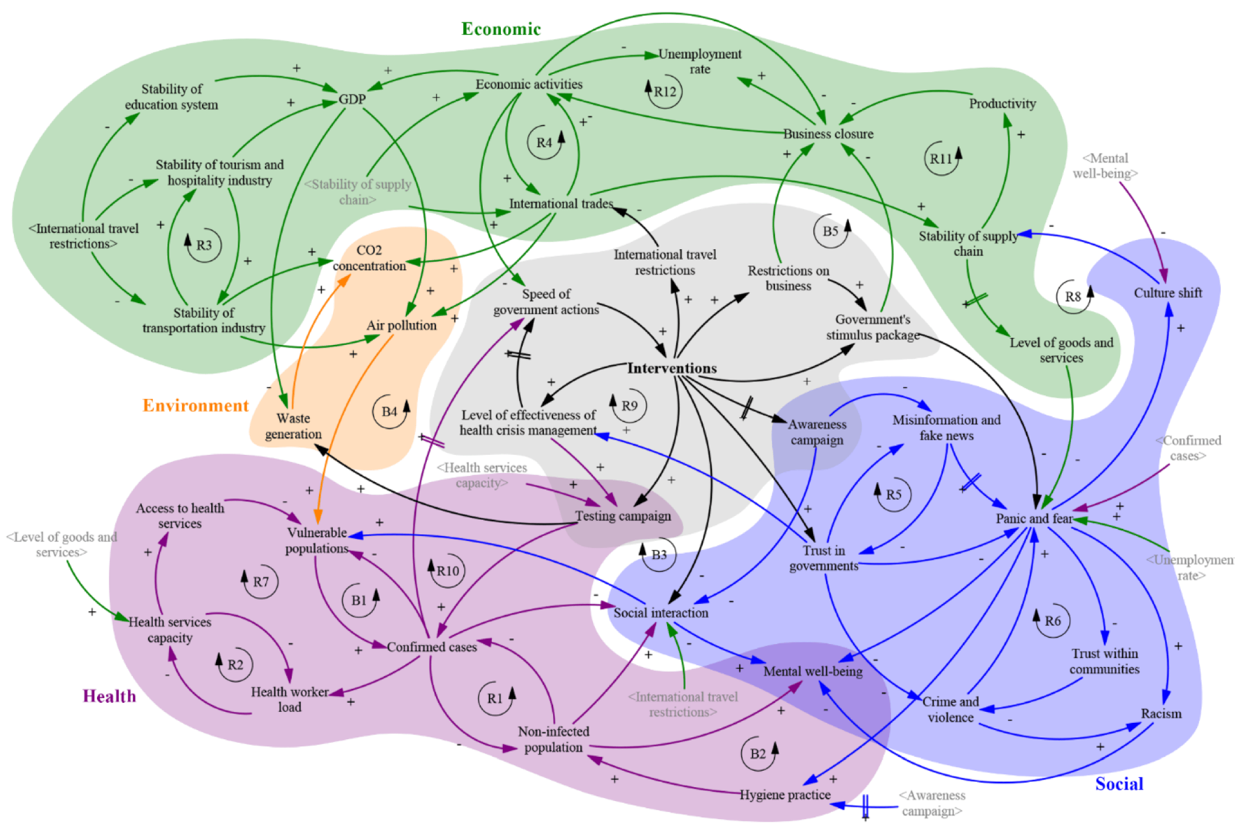
Causal Loop Diagram for COVID
https://www.mdpi.com/2079-8954/8/2/20

Slide 29
Choices About How We Represent Knowledge
Documents:
MS-Word
PowerPoint
Excel
Databases:
Relational
OLAP
Key-Value Stores
Column-Family Stores
Graph
Document Stores
Neural Networks
Large (GPT-4)
Small (Llama)
Internal Knowledge
Public Knowledge

Slide 30
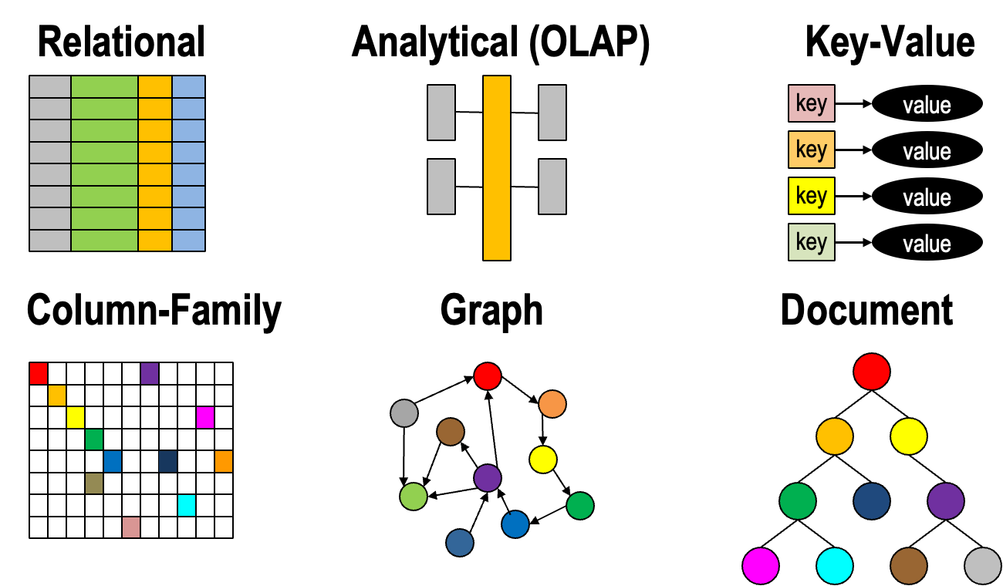
Database Architecture Options

Slide 31
Cognitive Bias and Choice Architecture
The way in which choices are presented to people and how the presentation can influence the decisions they make. This concept is a fundamental element in the field of behavioral economics, which explores how psychological, social, cognitive, and emotional factors affect the economic decisions of individuals and institutions and the consequences those decisions have on market prices, returns, and resource allocation.
The design of choice architecture involves arranging the context or environment in which people make decisions. This can be achieved through various methods, such as the framing of information, the order in which options are presented, the default options set, and the complexity or simplicity of the information provided. Here are some key aspects of choice architecture:

Slide 32
Key Factors that Impact Choice Architecture
Defaults: The pre-selected option among a set of choices can significantly affect consumer behavior because many people will stick with a default option due to inertia or the perception that it is recommended.
Framing: The way information is framed (e.g., as gains or losses) can lead to changes in perception and therefore different choices. This is closely related to the prospect theory developed by Kahneman and Tversky, which shows that people react differently when something is framed as a loss versus as a gain.
Nudging: Introducing small features or cues that can encourage people to make certain decisions without restricting their freedom of choice. For example, arranging healthier foods at eye level to nudge people towards making healthier eating choices.
Complexity and simplification: Simplifying choices can help people make decisions more easily, whereas too many options or overly complex information can lead to decision fatigue or avoidance.
Social norms and expectations: Presenting information about what others are doing can also guide choices, leveraging the power of social influence.
The effectiveness of choice architecture has been demonstrated in various areas such as public policy, health care, financial decision-making, and environmental sustainability. By understanding and applying the principles of choice architecture, policymakers, businesses, and other organizations can help steer people towards beneficial behaviors in a subtle yet impactful way.

Slide 33


Two Systems: FFS and VBC
Look at the pros and cons of each…
Fee For Services
Value-Based Care

Slide 34
Pros of Fee-for-Service (FFS) Model
Provider Productivity: Incentivizes providers to increase the volume of patients they see and services they provide, potentially improving access to care.
Simplicity in Billing: Relatively straightforward billing process as payments are tied to specific services or procedures rendered.
Autonomy in Clinical Decisions: Providers have high autonomy in determining which services are necessary, allowing flexibility in patient care based on immediate assessments.

Slide 35
Cons of Fee for Services
Cost Inflation: Encourages higher utilization of services which can lead to unnecessary tests or treatments, inflating healthcare costs without improving patient outcomes.
Fragmentation of Care: With a focus on individual services rather than overall patient health, it can lead to fragmented care where the coordination among different providers is minimal.
Lack of Outcome Focus: Since payment is not directly tied to outcomes, there is less incentive to ensure that the care provided is the most effective or necessary for the patient’s condition.

Slide 36
Pros of Value-Based Care (VBC) Model
Outcome-focused: Aligns incentives with patient outcomes, rewarding providers for effective management of patient health rather than volume of services.
Cost Efficiency: Potentially reduces healthcare costs by incentivizing preventative care and managing chronic diseases effectively, preventing expensive emergency interventions.
Holistic Patient Care: Encourages holistic care approaches, emphasizing coordination among various healthcare providers, which can lead to more comprehensive treatment plans and better overall health management.

Slide 37
Cons of Value-Based Care
Complexity in Implementation: Implementing VBC models can be complex, requiring significant changes in IT systems for tracking outcomes, training staff for new procedures, and renegotiating provider contracts.
Risk of Provider Burden: Providers may face increased administrative burdens and financial risks, especially if they are inadequately compensated for complex cases that require more intensive care.
Potential for Under-Treatment: There is a risk that in an effort to keep costs down, providers might under-treat patients or avoid high-risk patients, which can negatively impact patient care.

Slide 38
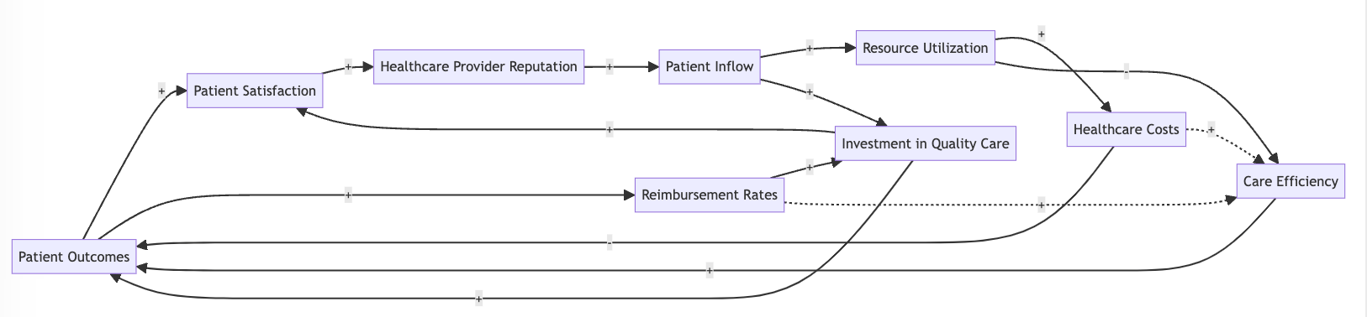
Ask ChatGPT to create a CDL on Value Based Care
Prompt: Please create a high-level causal loop diagram for value-based care. Express this diagram using Mermaid diagram notation.

Slide 39
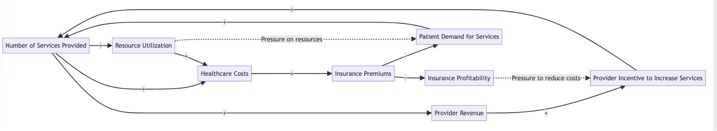
Pay for Services Causal Loop Diagram
Prompt: Please create a high-level causal loop diagram for pay-for-service model in healthcare. Express this diagram using Mermaid diagram notation.
Positive Feedback: # Services, Provider Revenue, Provider Incentives

Slide 40
Fee For Services (Mermaid Diagram)
graph LR
A[Number of Services Provided] -->|+| B[Provider Revenue]
B -->|+| C[Provider Incentive to Increase Services]
C -->|+| A
A -->|+| D[Healthcare Costs]
D -->|+| E[Insurance Premiums]
E -->|-| F[Patient Demand for Services]
F -->|+| A
E -->|-| G[Insurance Profitability]
G -.->|Pressure to reduce costs| C
A -->|+| H[Resource Utilization]
H -->|+| D
H -.->|Pressure on resources| F

Slide 41
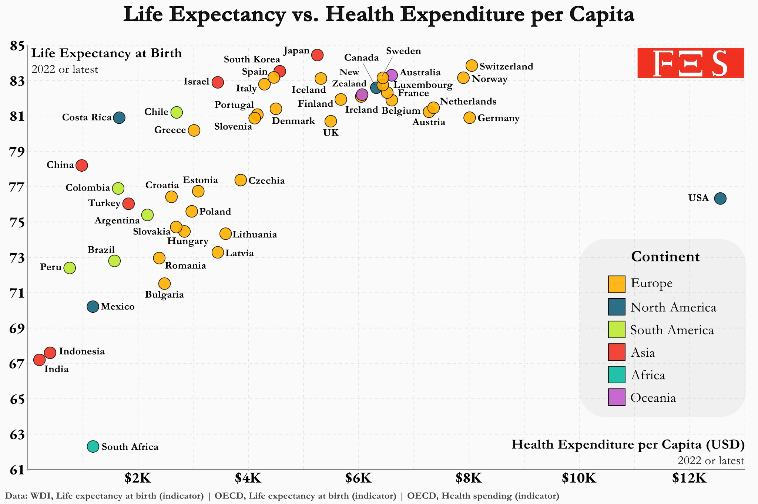
Life Expectancy vs. Per Capita Health Cost
https://dmccreary.medium.com/asking-ai-about-lowering-healthcare-costs-in-the-us-7224b4f958cc
Notes:
This chart used WDI and OECD data—an image from the Forensiceconomics post on Reddit.

Slide 42
Database Architectures
Relational
Analytical
Key-Value
key
value
key
value
key
value
key
value
Column-Family
Graph
Document

Slide 43
Bounded Positive Intent
Organization
Business Unit
Division
A focus on optimization at any of the levels below the organization level, putting a lower focus on how these decisions impact our members user experience.
“Suboptimzation”
Department
Bounded
Rationality
Team

Slide 44
One Organization – Many Siloed Computer Systems
System
System
System
System
System
System
System
System
System
System
How much effort should we put on integrating these discrete systems?

Slide 45
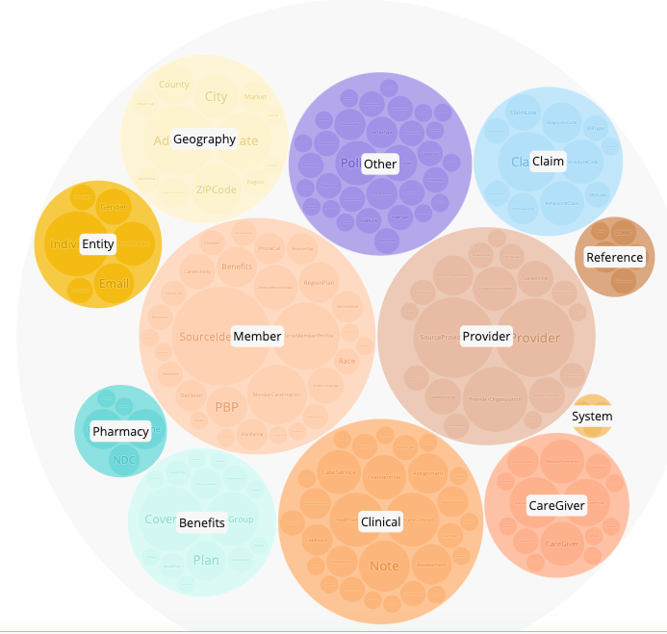
Integration is Hard!
Multiple business areas of a company
Different representations of the same data
Difficult to match and connect incomplete data
High cost to move data between systems in real-time
Source systems subject-matter-experts needed to interpret data
NPS

Slide 46
FDA Increase the Approval of ML Devices
The FDA approves more and more AI-related medical devices each year
In 2022, the FDA approved 139 AI-related medical devices, a 12.1% increase from 2021
Since 2012, the number of FDA-approved AI-related medical devices has increased by more than 45-fold
AI is increasingly being used for real-world medical purposes
Source: The AI Index 2024 Annual Report by Stanford University

Slide 47




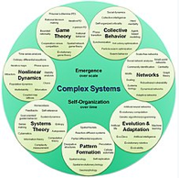

Key Systems Thinking Milestones Since 1956
Jay Forrester
Donella Meadows
Limits to
Growth
The Fifth
Discipline
Thinking in
Systems
Complex
Systems
In 1956 Jay Forrester (co-inventor of core memory) promoted the idea of “System Thinking” in the Systems Dynamics Group at MIT’s Sloan School.
In 1972, Inspired by Forrester, the book Limits to Growth was published by Donella Meadows and others. It used Systems Thinking to look a human-earth interactions and created simulations based on these observations.
In 2006, Peter Senge wrote “The Fifth Discipline” which positioned Systems Thinking as a core element of business strategy.
In 2008, Donella Meadows work on “Thinking in Systems” was published and promoted Systems Thinking as a general problem-solving discipline and encouraged it to be part of any critical thinking training.
Systems Thinking is now considered a part of Complex Systems (Wikipedia).
https://en.wikipedia.org/wiki/Systems_theory#History

Slide 48
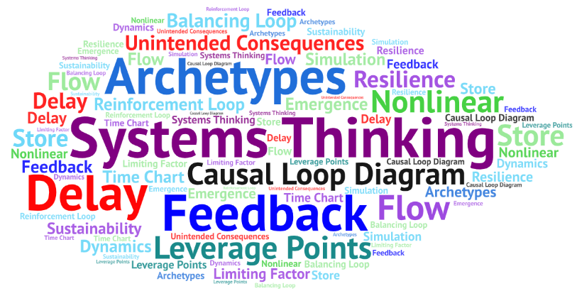
Systems Thinking Terminology

Slide 49












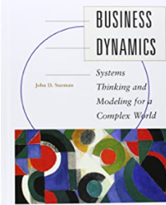
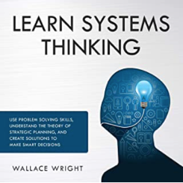


Over 20 Years of Established Best Practices
Don’t be intimidated!
Systems Thinking really is about a dozen core concepts
Most people can learn the basic principles of Systems Thinking in a few days

Slide 50
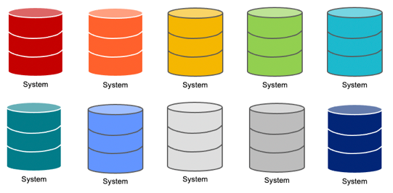
Project Silos vs Systems Thinking
Isolated Silo View
Systems Thinking View
Each project is an independent silo of effort
The success of any project will not impact the success of other projects
Project order is not relevant and project value is static in time
Project costs and benefits are easy to represent in a simple spreadsheet
Each project has their own team and their own backlog
Projects are dependent on another project success
The success of foundational projects may have a dramatic impact on other projects (x10 faster)
Project order is relevant and deferring customer benefit is needed until foundational projects are complete
Requires a deep understanding of how resources created by one project can be leveraged by other projects (reuse)
Extensive use of shared backlog of tasks

Slide 51

Search and Reuse
You can’t reuse what you can’t find
If you can’t find it, you will duplicate it… in a new silo
If you duplicate it, you will defend your silo
Great intranet search prevents silos from ever being created!

Slide 52
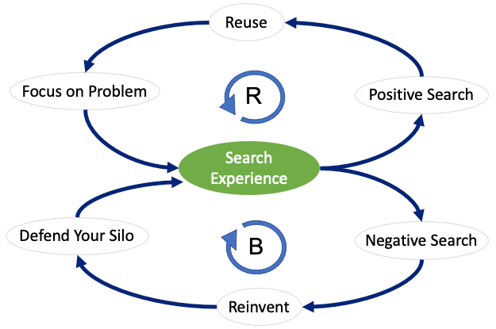
Search Causal Loop Diagram

Slide 53
Connected Data Strategy
Connected Data Strategy: An Enterprise Data Strategy pattern that brings focus to the business value of connecting disparate silos of data.
How much value?
At what cost?
$
$$$$
Lower Value
Higher Value

Slide 54

Unconnected Data is a Liability
Kendall Clark
https://www.stardog.com/blog/unconnected-data-is-a-liability

Slide 55


Systems Thinking is NOT
a programming technique
a certification you can get
a silver bullet to all our integration problems
Systems Thinking is a type of critical thinking that helps us break down siloed thinking

Slide 56


What exactly is “A System”?
A collection of components that interact together to produce some sort of behavior of the whole
Systems can have subsystems
Systems can be part of other systems
Dynamic systems have feedback

Slide 57
Data Flow Diagrams (DFD) vs. Causal Diagrams
Data
Data
Data
Warehouse
Source
ETL
Job
Rain
Wet
Grass
Causes
Data Flowing Between Systems
Direction on arrows
Causal Relationship
Direction is also relevant
but may not be “data”

Slide 58
Linear (static) vs Circular (dynamic)
A
B
C
A
B
C
Static Causal Analysis
Dynamic Causal Analysis
with Feedback
Causal Loop Diagram (CLDs)

Slide 59
Warning! Don’t Confuse Data Flows with Causality
DFD != CLD
Many great architects have strong skills drawing data flow diagrams!
Very few architects have formal training in creating causal diagrams.

Slide 60




Example: The AI/ML Flywheel
Data
Creates
Use to build
Feedback
Machine Learning Model
Can gather
Use to make
Prediction
Feedback creates more data which creates more precise machine learning models.

Slide 61
Causal Loop Diagrams (CLD)
Positive
Feedback
Loop
R
Reinforcing
Loop
Current
State
Negative
Feedback
Loop
Balancing
Loop
B
Primary tool for facilitation of discussion of feedback cycles.

Slide 62
Systems Thinking Archetypes
An ideal example that illustrates systems thinking.

Slide 63
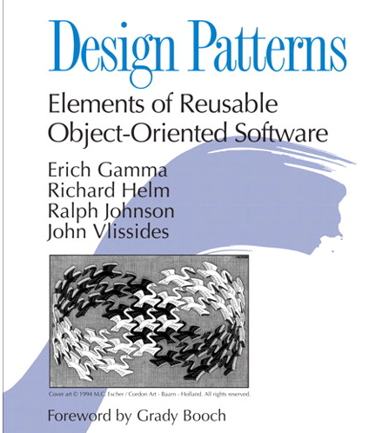
What is a Systems Thinking Archetype?
Design Patterns for Systems Thinkers
Archetypes are to Systems Thinking what Patterns are to software design.
A small set of system structures that produce common behavioral patterns across many different fields.
Used to teach Systems Thinking concepts

Slide 64
Sample Archetypes for Technologist
The Tragedy of the Commons – Share resources and scalability
Metcalf’s Law - Network Effects and standards
The AI Flywheel – Data, models, prediction and feedback
Search and Reuse – You can’t reuse what you can’t find
Database Model Precision – Model shareability across systems
The Enterprise Knowledge Graph – Scalable shared knowledge

Slide 65




Tragedy of The Commons
Farmer Brown
Farmer Smith
Farmer Cooper
The Commons
Farmer Jones
Farmer Baker
Farmer Anderson

Slide 66
Tragedy of The Commons
A situation in economic science when individual users, who have open access to a resource unhampered by shared social structures or formal rules that govern access and use, act independently according to their own self-interest and, contrary to the common good of all users, cause depletion of the resource through their uncoordinated action.
https://en.wikipedia.org/wiki/Tragedy_of_the_commons
The more everyone uses a resource, the less valuable it becomes.

Slide 67
Causal Loop Diagram for Individual Farmer
+
Delay
Fatten Cows
Delay
Get More Cows
R
Use “Free” Commons
+
Cows in
Herd
Reinforcing Loop

Slide 68
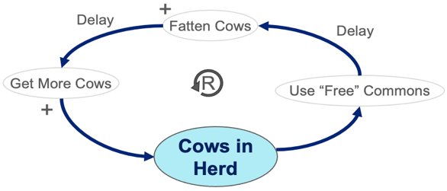

Total Activity And Resource Limit
B
Total Activity
Total
Gains
Delay
Resource
Limited!
B

Slide 69
Utility is a Non-linear Function of Usage
Usefulness to
all Farmers
Overgrazing Point
Uselessness
Collective Usage

Slide 70







Databases are Also Shared Resources
Marketing
Product Development
Sales
The Scale-Out Enterprise Database
Customer Support
Information Technology
Research

Slide 71
Query Response vs. Time of Day
Average Query Response Time in Seconds (M-F)
10
LUNCH
5
2
Time of Day
MIDNIGHT
8 AM
NOON
5PM
Many users fighting for a shared resource with limited capability
The more you use it the lower the value to others

Slide 72
Causal Loop Diagram for Single Business Unit
+
Delay
Strategy
Quartey
Financial
Statements
R
MBOs
Profits and
Growth
Reward Executives for Profits and Growth
only within their own Business Unit.
+

Slide 73
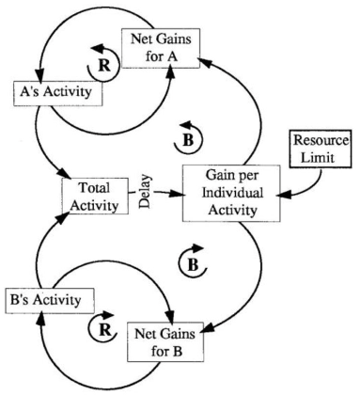
Multiple Users of Any Limited Shared Resource
Modern B/R notation from diagrams by Peter Senge

Slide 74

Metcalfe’s Law (Network Effect)
The value of a telecommunications network is proportional to the square of the number of connected users of the system (n²).
VALUE
https://en.wikipedia.org/wiki/Metcalfe%27s_law
NUMBER OF DEVICES
The more everyone uses a standard, the more valuable it becomes.

Slide 75
Network Effects (Metcalfe’s Law)
The value of any device on a network standard grows exponentially as the number of connections increase.
Lower Cost Per Device
Higher Adoption
More Devices
Manufactured
R
Increased Use
Higher Adoption
Networking
Standard
Decreased Use
Lower Adoption
Use Alternate Standards
B
Users Can’t Communicate
High Cost Per Device

Slide 76
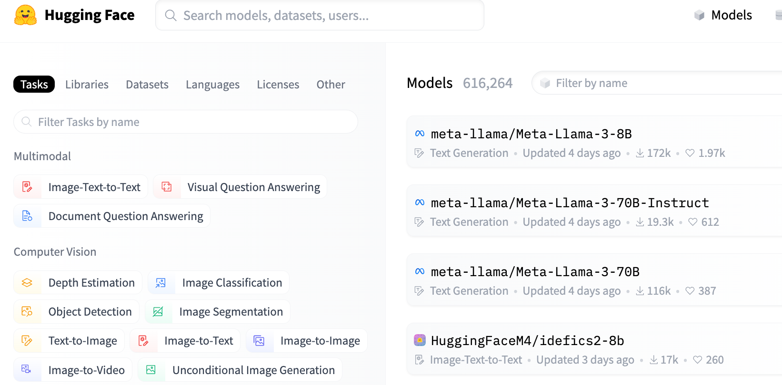
HuggingFace - $2 Billion Evaluation in 5 Years!
51K machine learning
models in June 2022
R
616K machine learning
models in April of 2024

Slide 77
Connected Data Strategy
How much value?
At what cost?
Higher Value
$$$$
Lower Value
$
Connected Data Strategy: An Enterprise Data Strategy pattern that brings focus to the business value of connecting disparate silos of data.

Slide 78

Goal: Objective Weighing of Pros and Cons
Graph Cost
New Insights
Kafka Streaming Cost
Easy to measure
Data Science
Productivity
CDC Cost
Hard to measure
Member Journey
Cons
Pros
We are starting to learn the benefits of connected data: Customer 360
It takes time and effort to create high-quality connected data
Can we objectively measure each of the pros and cons?
What is the value of “new insights?”
How is our decision making driven by what is easy to measure?

Slide 79
Product Recommendation Engine Causal Loop Diagram
Additional
Purchases
Right Products Fast
Additional
Revenue
Great Recommendations
Increases
Member NPS
No New
Revenue
Poor Recommendations
Decreases
No
Purchases
Wrong Products Slowly
NPS = Net Promoter Score Likelihood to recommend

Slide 80


Customer Support Chatbot
Chat Log
Creates
Use to build intent detection model
More feedback is used to build better intent detection models.
Feedback
Machine Learning Model
Did that answer your question?
Attempt to answer question
Chatbot Answer

Slide 81
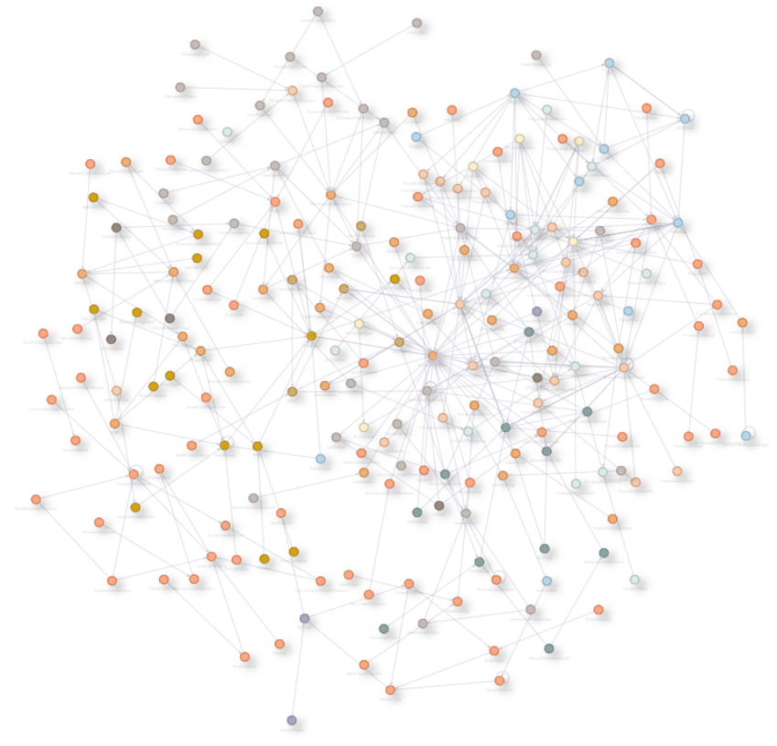
Healthcare Data Model Precision and Cost Sharing
Healthcare Graph
Data Model
212 Vertex Types
600+ Relationships

Slide 82
Data Model Precision, Completeness and Cost Sharing
Higher Sharing of EKG
Cost Savings
Precise Data Agreement
Precise and complete data models allow multiple business units to share EKG infrastructure costs.
More
High Quality
Data Model Precision
Less
Low Quality
Duplication and Higher Costs
Poor Data Models
Constant
Rework
“We just modeled our graph data just like our RDBMS to minimize joins.”

Slide 83
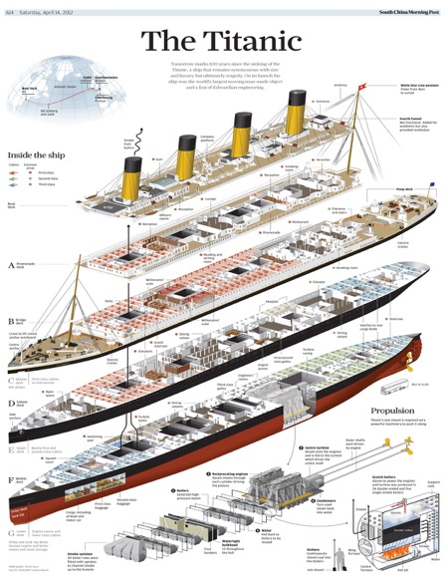
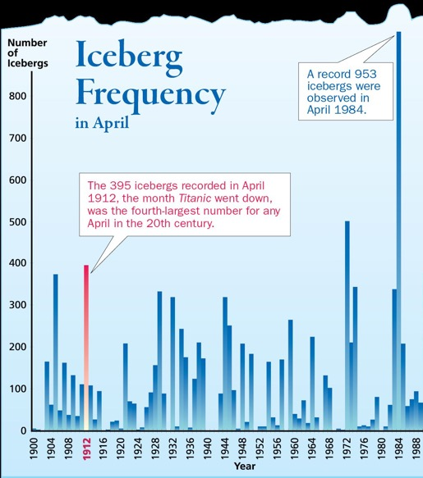
Modeling Precision
“All models are wrong. Some models are useful.” - George Box
Graph data models are better at modeling the real world.
Models that are correct are easily shared across business units.

Slide 84
Architectural Tradeoff and Analysis Method
Business
Drivers
Quality
Attributes
User
Stories
Analysis
Architecture Plan
Architectural
Approaches
Architectural
Decisions
Tradeoffs
Impacts
Sensitivity
Points
Non-Risks
Distilled info
Risk Themes
Risks
See Chapter 12 of Making Sense of NoSQL

Slide 85
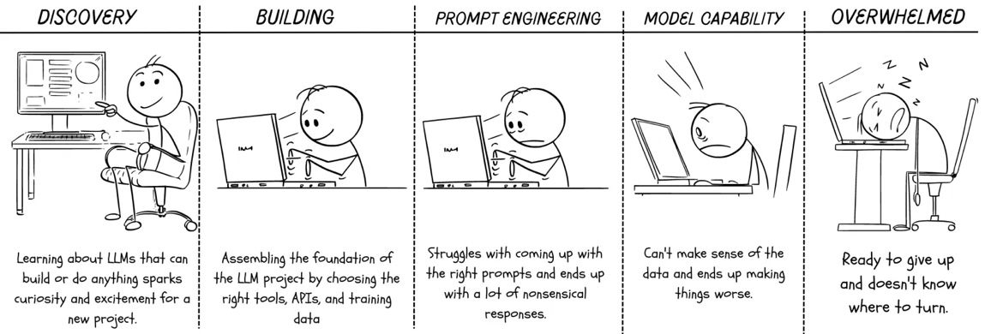
Process for Building a LLM Application

Slide 86
Docstrings
Docstrings, short for documentation strings, are special strings in programming (commonly in Python) used to describe the purpose, functionality, and usage of code elements like functions, classes, or modules. Typically written as the first statement within a function or a class, docstrings provide insights into what a specific block of code is supposed to do.

Slide 87

Call Obviation
Call obviation is the process of reducing or avoiding direct phone calls by using alternative methods of communication or by addressing customer needs through automated means.
This could involve using chatbots, interactive voice response (IVR) systems, self-service portals, or other technology-based solutions to handle customer queries without involving a human agent.

Slide 88
Avoid a $10 Cost of a Call to a Call Center
The cost of a typical call to a call center varies depending on multiple factors, including the industry, complexity of the call, location, and wages of call center agents.
As a general estimate, it can range from $5 to $15 per call. Simple calls like account balance inquiries are on the lower end, while complex calls like technical support or financial services inquiries can be at the higher end.

Slide 89
Chatbot Savings
When a chatbot successfully answers a call, it can save a significant amount of money for businesses. This is because chatbots reduce the need for human intervention, allowing businesses to minimize labor costs and improve efficiency.
Larger-scale implementations of chatbots can lead to substantial cost reductions over time. Additional benefits include faster response times, improved customer satisfaction, and reduced call center workloads.

Slide 90
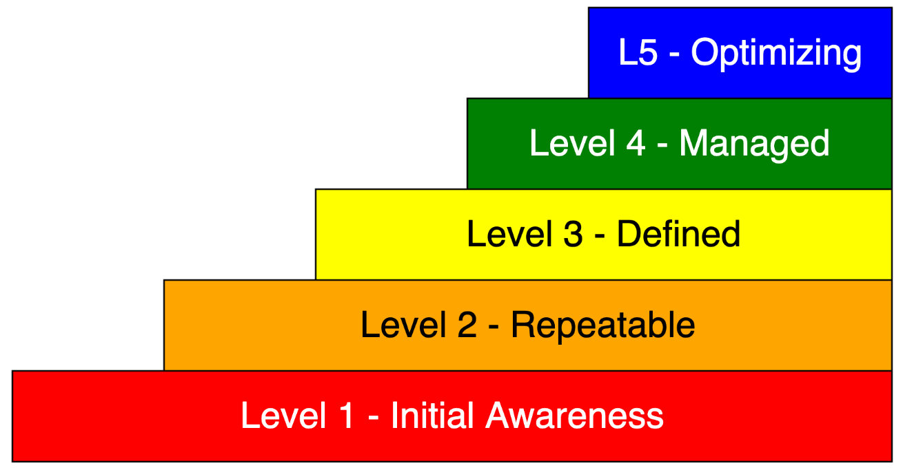
Custom Strategies To Improve
Depending on where you are today,
your micro-strategies will vary.

Slide 91
Level Distribution Histogram
Number of
Organizations
at Level
State Agencies
In Minnesota
VC Funded Bay
Area Organizations
Initial
Repeatable
Defined
Managed
Optimized
80% of companies are at L2: Repeatable

Slide 92
Influence Diagram Graph
CEO
Decision Maker
CIO
Legal
HR
Sales
CFO
R&D
Product
Marketing
The color indicates their awareness of the potential of AI in your organization
The weight of the line shows their influence on the decision maker(s)

Slide 93
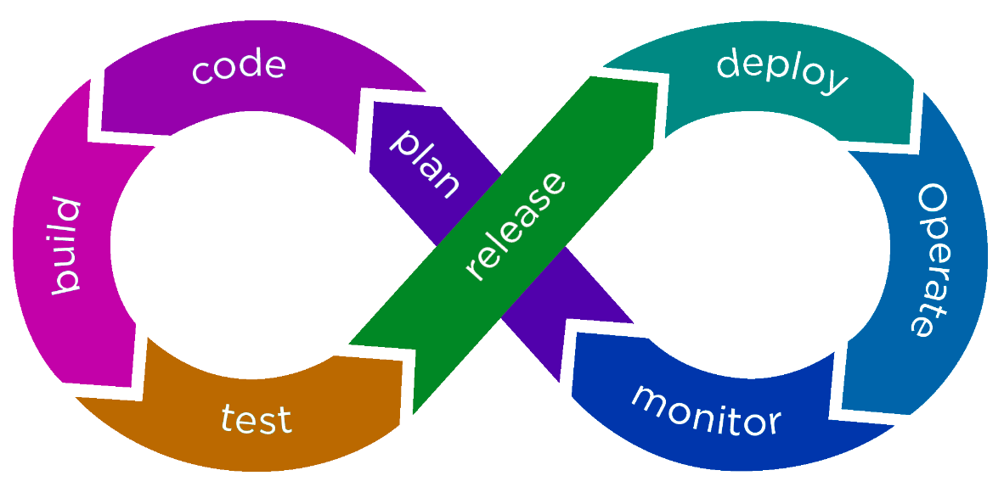
What Parts of Dev/Ops Does Gen AI Impact?
DEV
OPS
All of them!

Slide 94

Explainability and AI
Deep neural networks have low explainability (black box models)
Other machine learning models help explain why recommendations were made
https://dmccreary.github.io/xai/

Slide 95
GenAI Intelligent Agent Architecture
Key
LLM Task
New GenAI App
English
Infrastructure
Other GenAI Apps
Single Task
Multiple Tasks
GenAI Wrapper
REST APIs
Agent Safety Guardrails
English
Goal Decomposition
Task Ordering
GenAI Wrapper
Knowledge
Graph
Estimation
Logging
Scheduling
English
Document Cracking
Embedding
Verification
Collection
Notification
Goal: define loosely coupled resilient architecture where clearly defined interfaces allow components to be swapped in and out has technology changes and new contracts are negotiated.

Slide 96
Conclusions
Never mistake a clear view of the future for a short distance. - Paul Saffo
AI is already having a large impact on healthcare
With the right guardrails, there are many additional opportunities for both quality improvement and cost reduction
Systems thinking can help us find solutions to "wicked problems"

